Slide 1
EI Project Demonstration: Public Transport System
Group 3
Eugene Choy Wen Jia Ho Min Kit Winston Ho Wei Hong Sim Li Jin Yin Yukun Yong Fu Xiang
Image retrieved from www.travelweekly-asia.com

Slide 2
Scenario
Public Transport network serves hundred of thousands of passengers everyday. Any disruption in the service would require mitigation actions to be taken to ensure minimal disruptions to the passengers.
An well-integrated public transport network with the various stakeholders will help enhance the communication and automate processes when mitigation actions are required

Slide 3


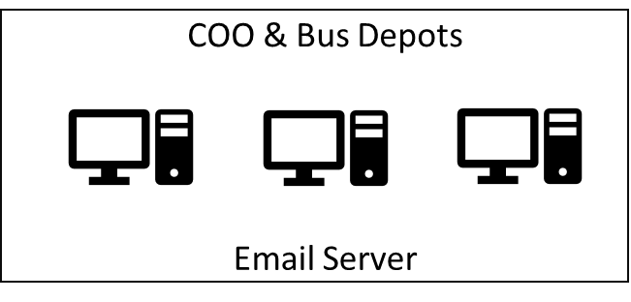









t.weather
t.ns.listener
t.ew.listener
Train Mgmt Messaging System
Break down messages
Heavy Rainfall Report
Train Listeners
Twitter Plugin
t.weather
t.<dynamic>.listener
Send Emails
jdbc
busdepotname
breakdown.xml (new_breakdown.xsd)
TIBCO BW
EMS
q.breakdown
q.deployed
q.depot.<dynamic>
t.weather
t.<dynamic>.listener
P q.breakdown (Q)
P q.deployed
C q.deployed (Q)
File Poller
busRequest.xml (new_busRequest.xsd)
Bus Management System
C q.depot.<dynamic>
HTTP
busdepot
Get nearest Bus Depot
Web Service
HTTP
q.depot.jurong
q.depot.tampines
q.depot.toapayoh
HTTP
Schedule Management
Web Service (PHP)
Weather API
(wrapped NEA Api w code)
Bus Depots Deploy Mgmt System

